Slide 1
Images&Captions

Slide 2
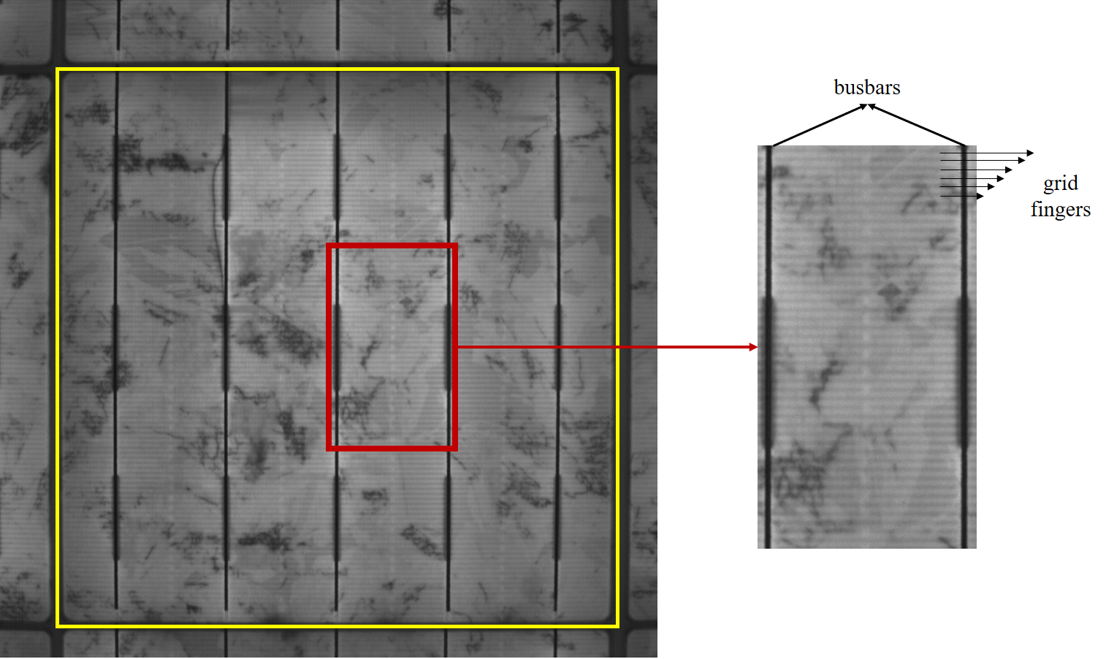
Preprocessing
The ROI of a solar cell. The yellow box indicates the borders of the cell. The ROI is specified as the inner region of the border except for the busbars. In order to show the grid fingers clearly, the red box is zoomed in.

Slide 3
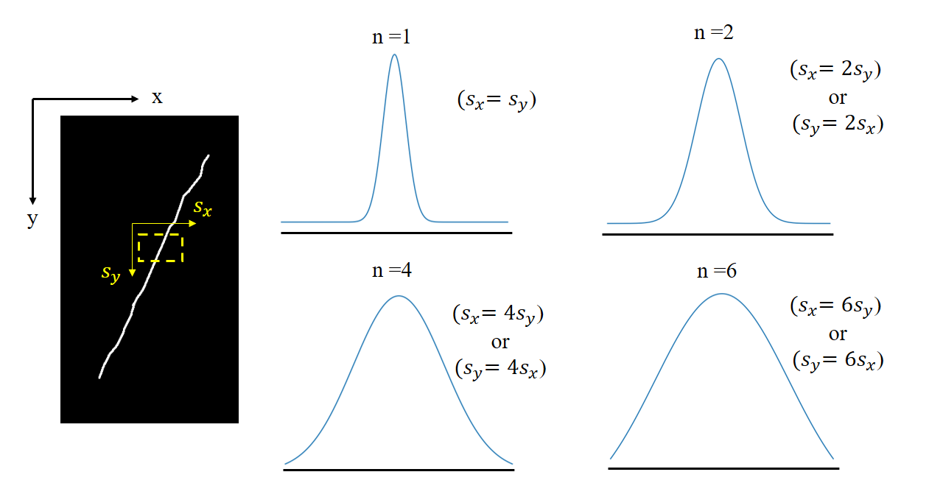
Crack Detection/ Adapted Vesselness
In the labeled image, the scales are demonstrated in both directions. The curves indicate the size of the Gaussian distributions with various degree of asymmetry at s = 1.

Slide 4
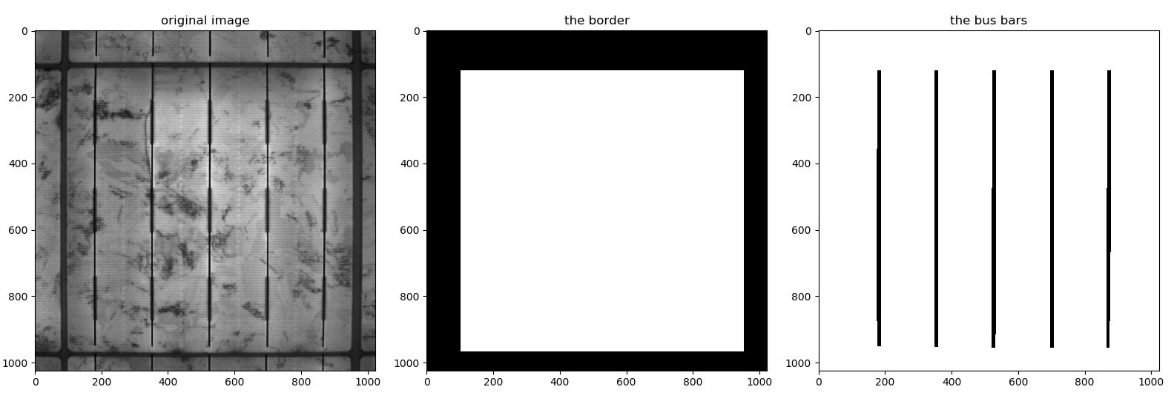
Results/Preprocessing
Left: the original image Middle: the border of the solar cell Right: the identified busbars

Slide 5
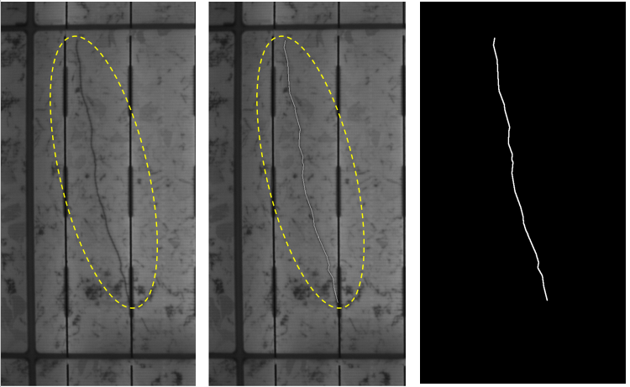
Results/Crack Detection
The labeling. Left: the original image. Middle: the label. Right: the ground truth image.

Slide 6
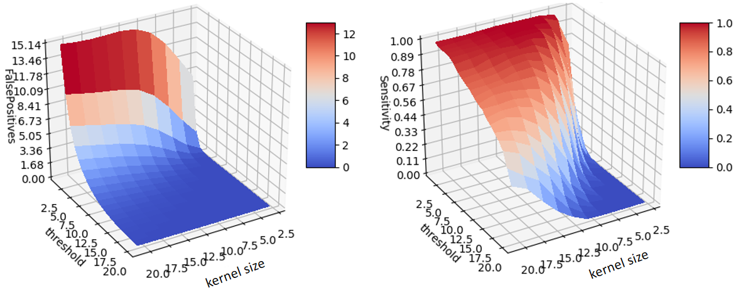
Results/BP
The heatmaps demonstrating the false positive rate and the sensitivity of the bandpass filter at various kernel sizes and threshold levels.

Slide 7
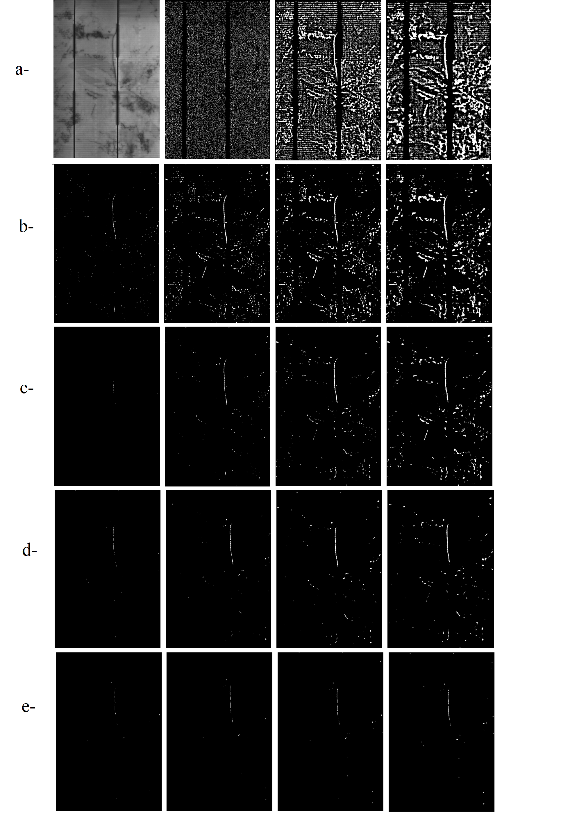
Results/BP
The results of the bandpass filtering. From left to right: a- The original image and the computed images with the threshold = 1, and kernel sizes 3, 11, 19. b- threshold = 5, and kernel sizes 5, 9, 13, 19. c- threshold = 9, and kernel sizes 5, 9, 13, 19. d- threshold = 13, and kernel sizes 9, 13, 17, 21. e- threshold = 19, and kernel sizes 13, 17, 19, 21.(I had to divide the image, normally it’s one piece)

Slide 8
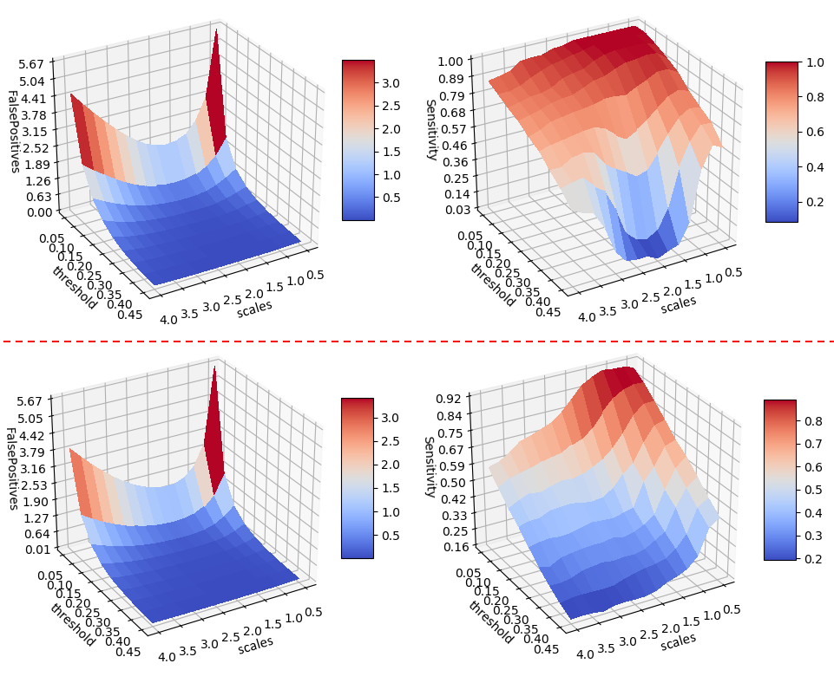
Results/ original Vesselness
The heatmaps demonstrating the false positive rate and the sensitivity of the Vesselness at various scales and threshold levels. Top: large crack. Bottom: the “hard” case.

Slide 9
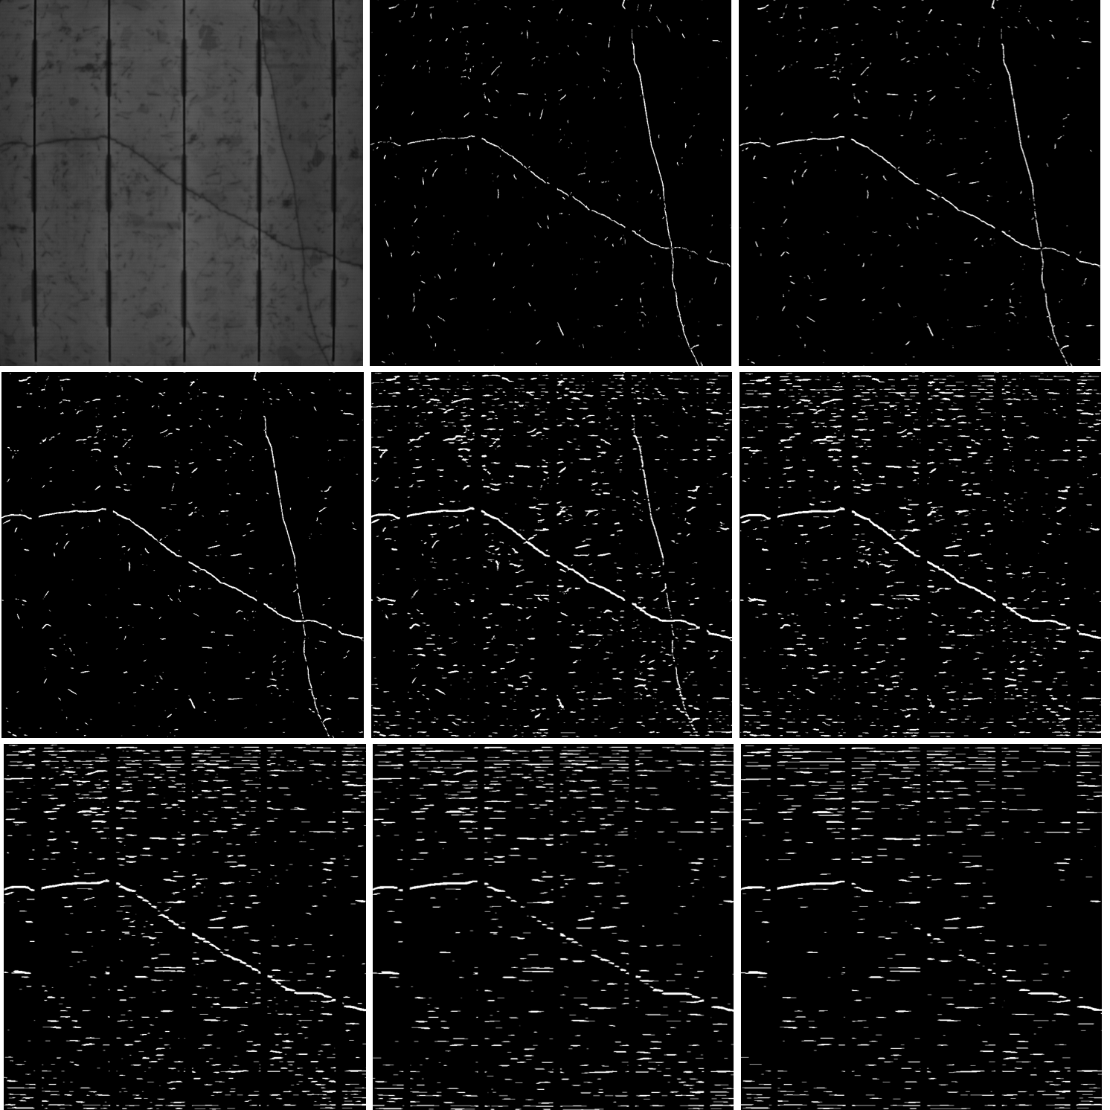
Results/ adapted Vesselness
The adapted Vesselness applied only on x-axes. (from left to right) Top: the original image, the Vesselness result (n = 1), the adapted Vesselness (n = 1:5). Middle: the adapted Vesselness (n = 2; 3; 4). Bottom: the adapted Vesselness (n = 6; 8; 10).

Slide 10
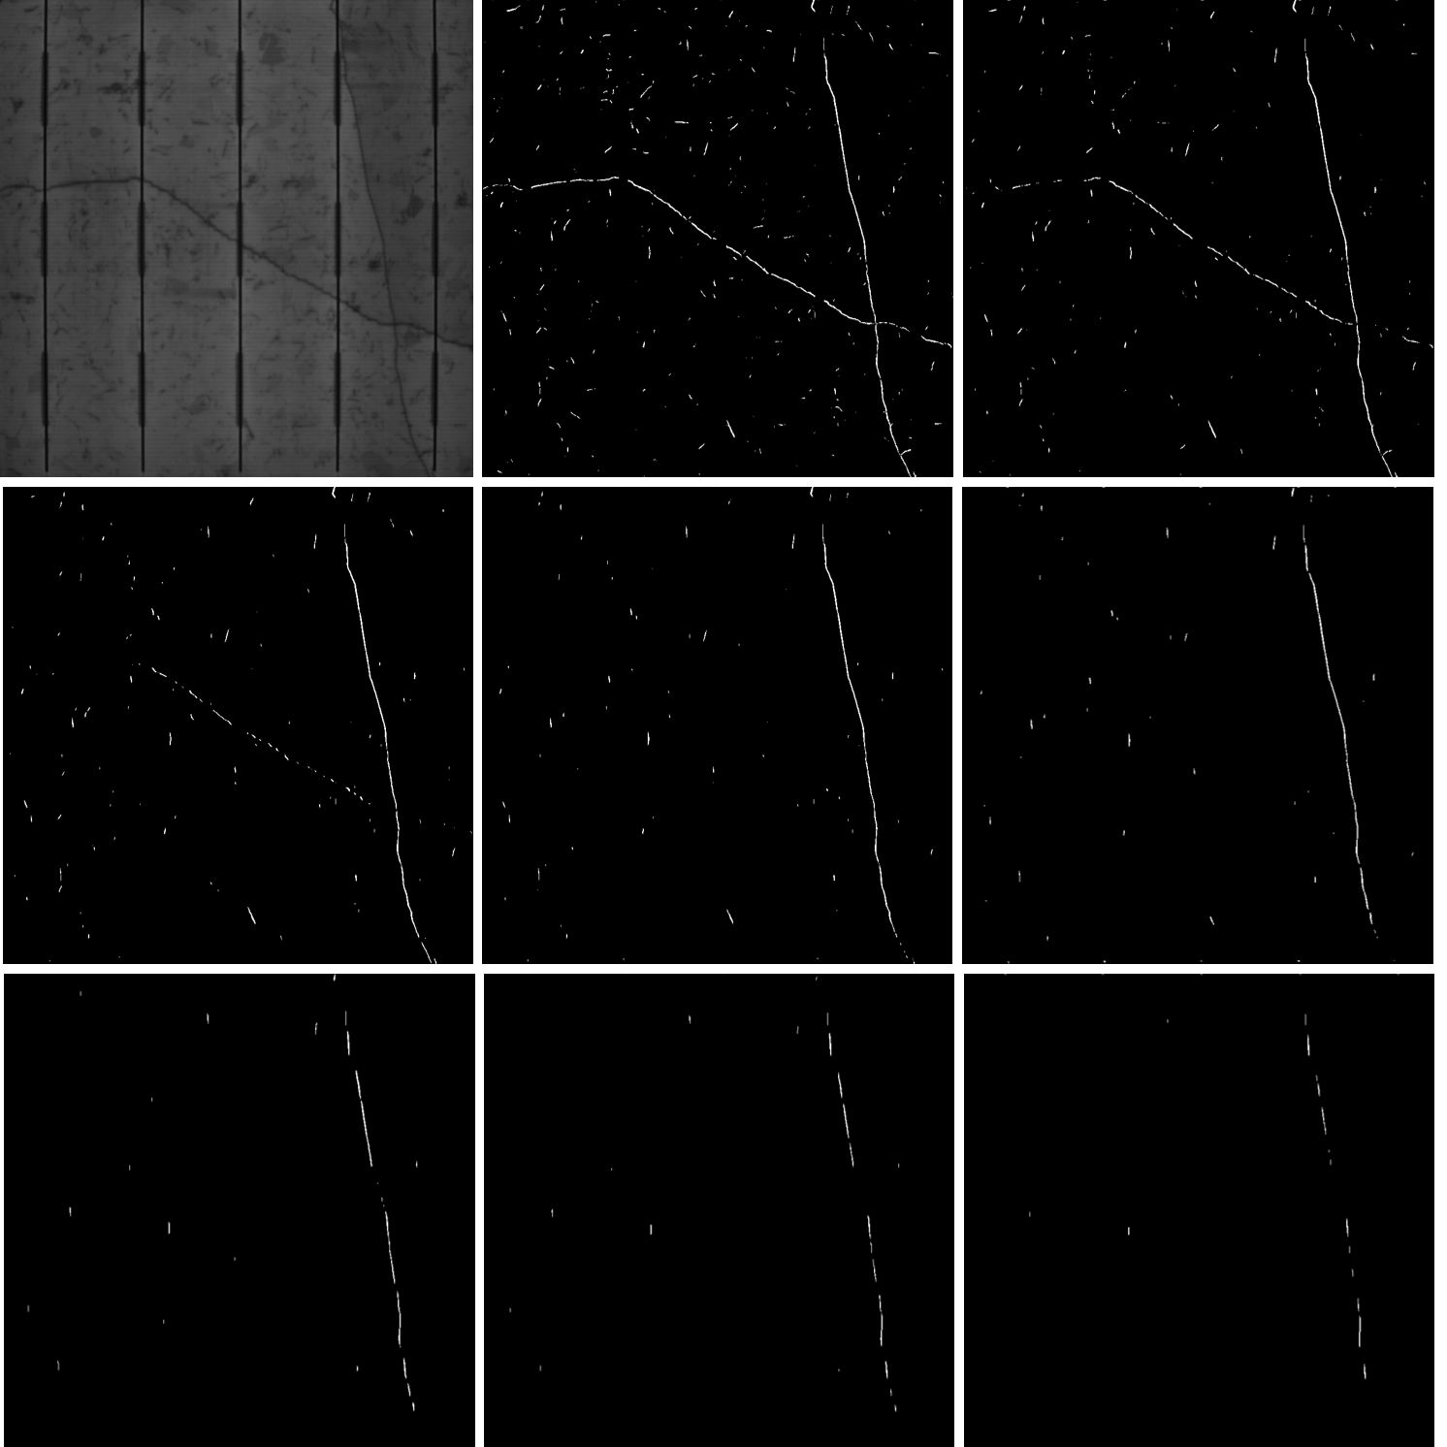
Results/ adapted Vesselness
The adapted Vesselness applied only on y-axes. (from left to right) Top: the original image, the Vesselness result (n = 1), the adapted Vesselness (n = 1:5). Middle: the adapted Vesselness (n = 2; 3; 4). Bottom: the adapted Vesselness (n = 6; 8; 10).

Slide 11
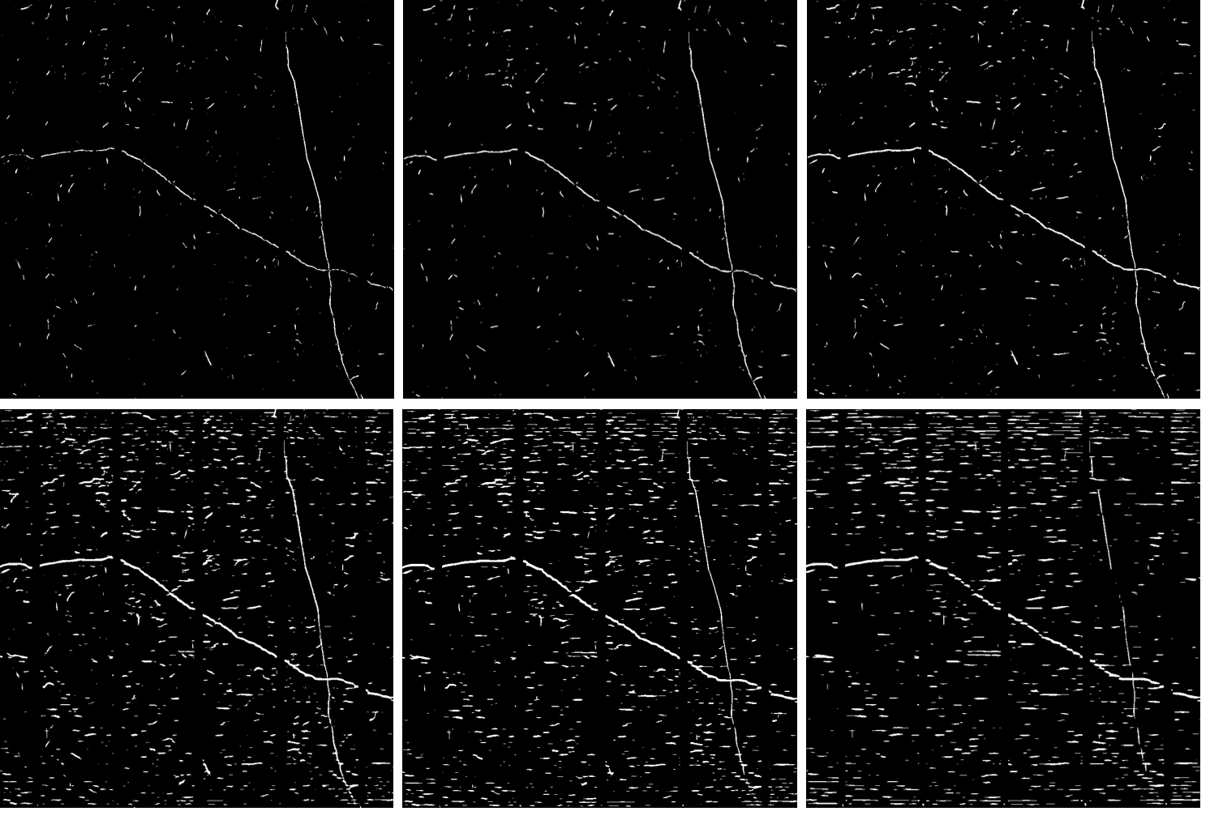
Results/ adapted Vesselness
The results of maximization at s = 1 with various n values. The asymmetric Vesselness result with one degree of asymmetry is maximized (from left to right) Top: (n = 1; 1:5; 2) Bottom: (n = 3; 4; 6)

Slide 12
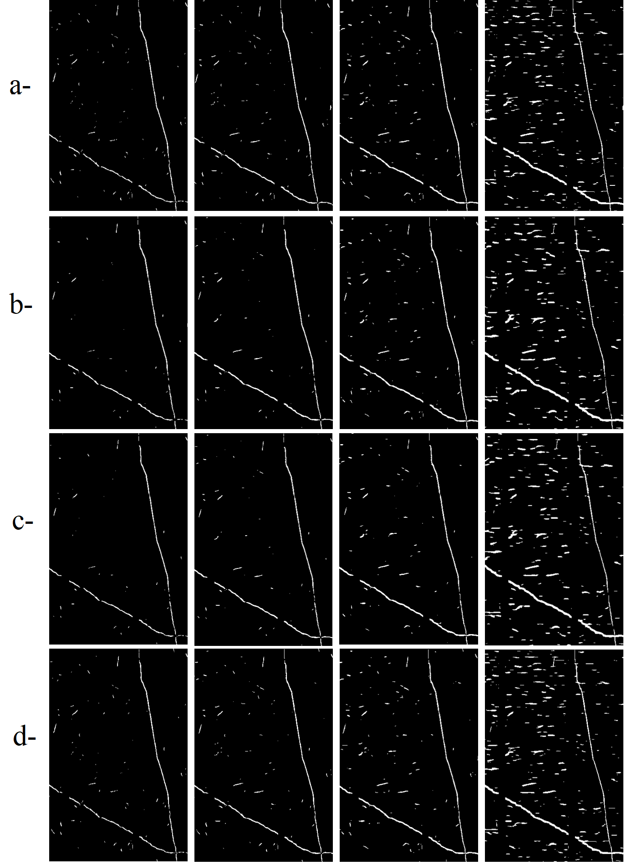
Results/ adapted Vesselness + Filters
Denoised maximization results. (from left to right) n = 1; 1:5; 2; 4. a- The adapted Vesselness without denoising. b- BL with the kernel size of 5. c- AD with iteration number of 5. d- GF with the radius of 2.

Slide 13
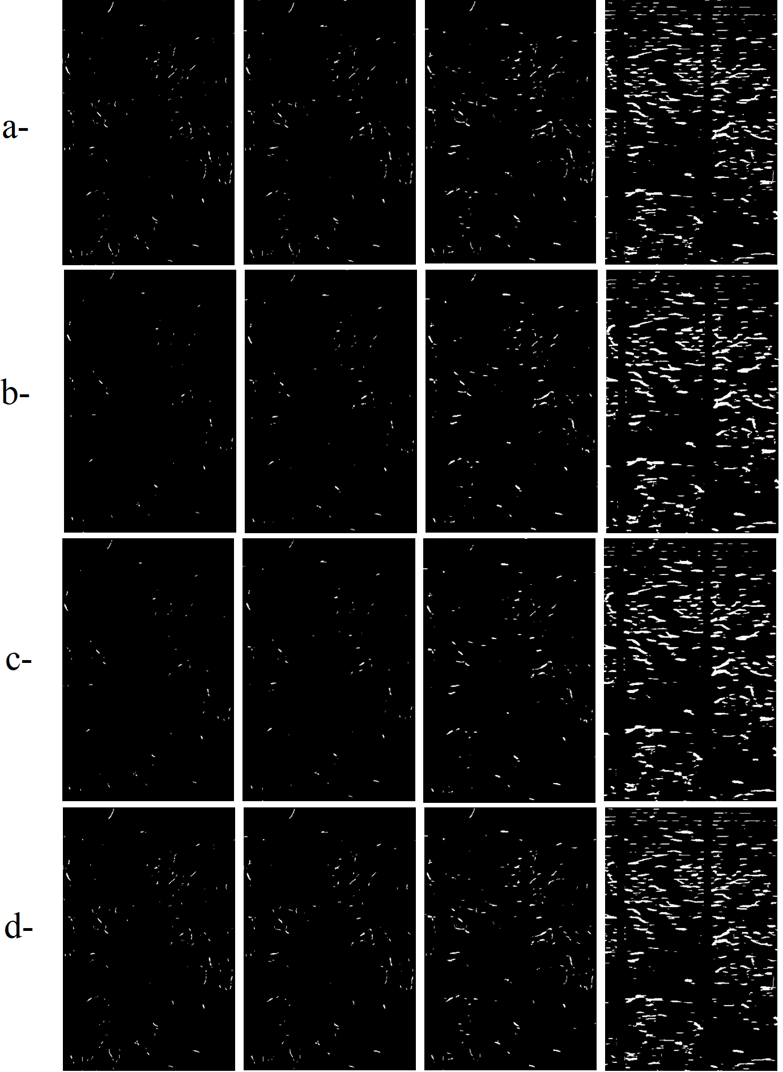
Results/ adapted Vesselness + Filters
Denoised maximization results for a no-crack image. (from left to right) n = 1; 1:5; 2; 4. a- The adapted Vesselness without denoising. b- BL with the kernel size of 5. c- AD with iteration number of 5. d- GF with the radius of 2.

